Slide 1

zeek
1805092- Ishika Tarin
1805114- Afroza Parvin Disa

Slide 2
What Is Zeek?
A network security monitor (NSM) to support investigations of suspicious or malicious activity.
A fully customizable and extensible platform for traffic analysis.
A platform supporting extensive set of logs describing network activity, seen on the wire, but also application-layer transcripts.

Slide 3
Zeek features
Live Monitoring of traffic
Storing live traffics in Packet Capture (pcap) Files
Command line utility with zeekcontrol
Browsing Log Files
Notification and log file update

Slide 4

Live traffic monitoring & Network ANalysis

Slide 5
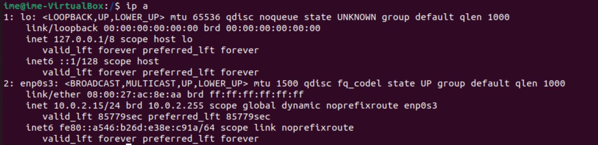
Command Line: ip a
It lists all network interfaces (both physical and virtual) that are currently configured on system.
'lo' is the loopback interface with IPv4 address 127.0.0.1 and IPv6 address ::1
'enp0s3' is the physical interface with IPv4 address 10.0.2.15/24 and IPv6 address fe80::a546:b26d:e38e:c91a/64.

Slide 6
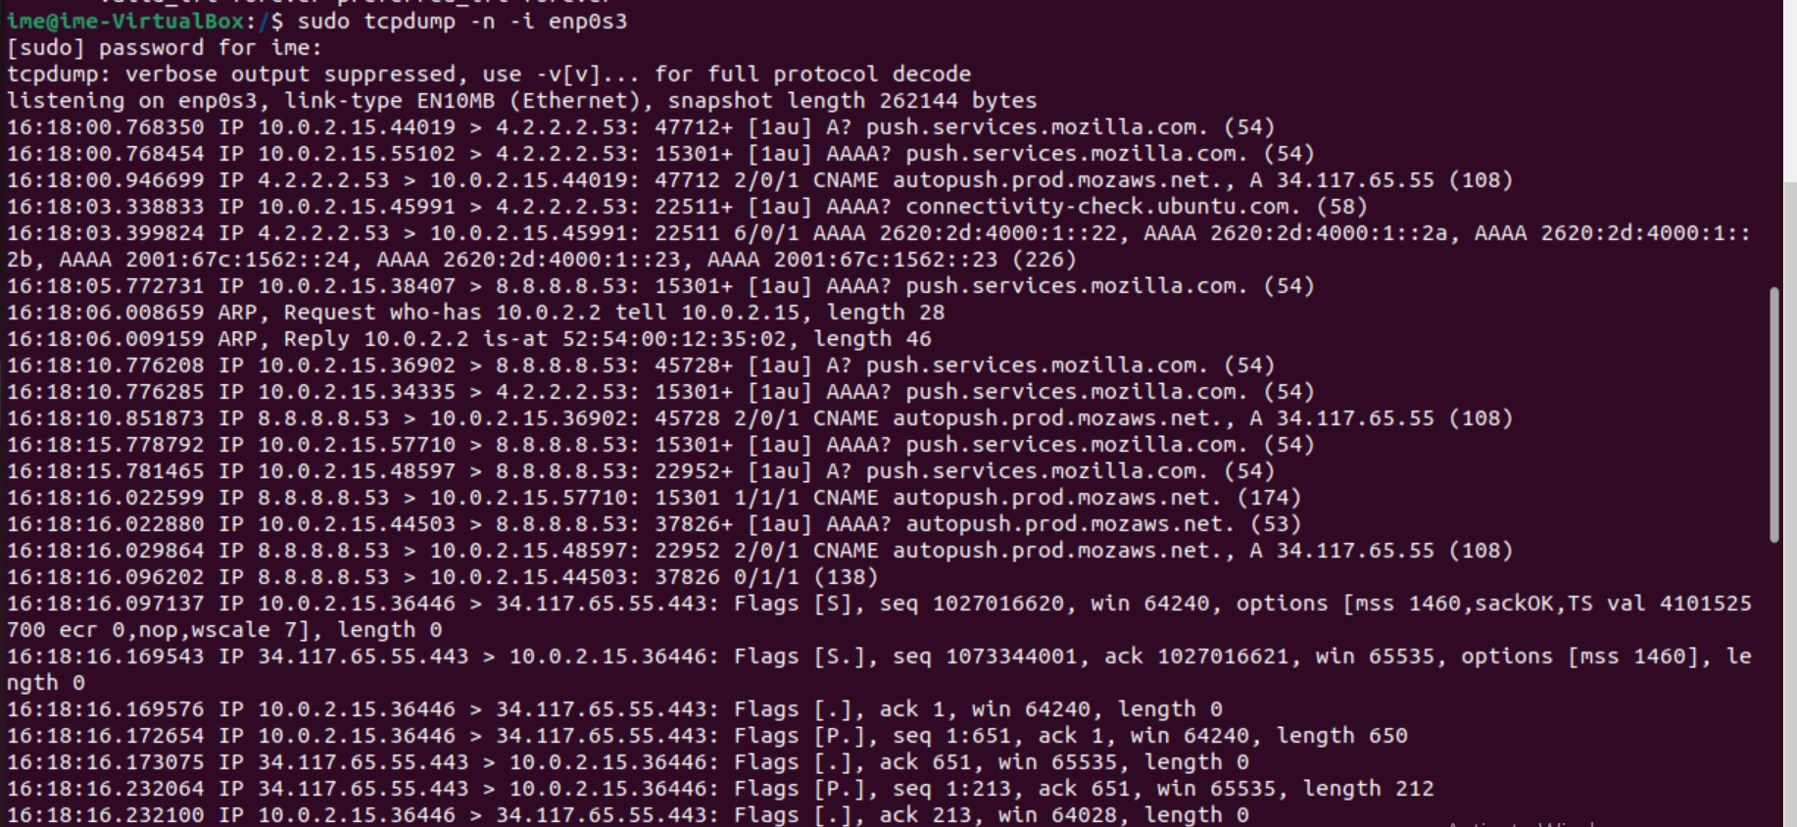
Command Line: sudo tcpdump -n -i enps03
Tcpdump starts listening on the enp0s3 network interface.
Each line represents an IPv4 packet captured at a specific time, showing the source and destination IP addresses, port numbers, TCP flags indicating an acknowledgment, window size, and length of the payload.

Slide 7
The line 14:38:10.400419 IP 10.0.2.15.39134 > 34.117.237.239.443: Flags [.], ack 1035, win 64028, length 0
14:38:10.400419: This timestamp indicates the time at which the packet was captured.
IP: This indicates that the packet is an IPv4 packet.
10.0.2.15.39134 > 34.117.237.239.443: This part indicates the source and destination addresses along with their corresponding port numbers.
10.0.2.15 is the source IP address. ,39134 is the source port number.
34.117.237.239 is the destination IP address., 443 is the destination port number.
Flags [.], ack 1035: Here [.] indicates that this is an acknowledgment packet. ack 1035 means the acknowledgment number is 1035, indicating that the receiver has successfully received up to sequence number 1035.
win 64028: This shows the window size, which is 64028.
length 0: This indicates the length of the data payload in the packet. In this case, the length is 0, suggesting that this is a control or acknowledgment packet without any payload data.

Slide 8
Storing live traffics in packet capture files

Slide 9
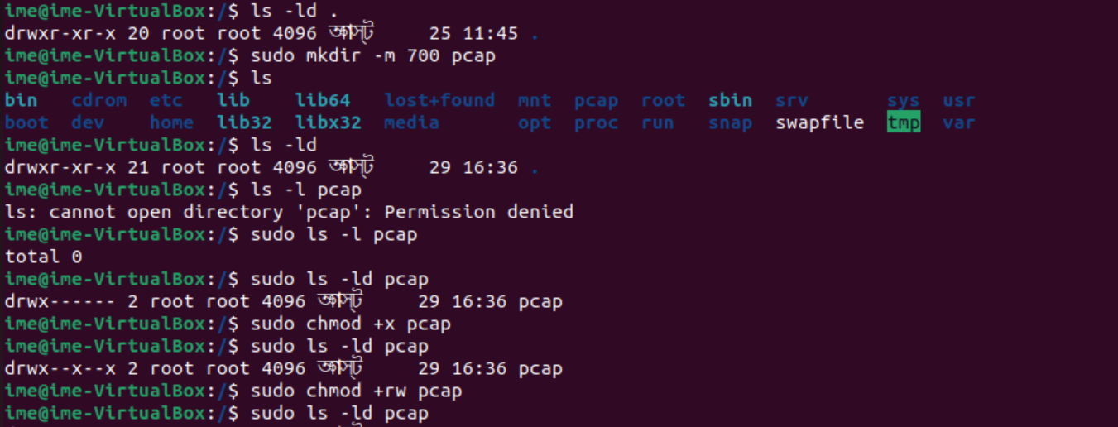
Opening a pcap file:
ls -ld
sudo ls -ld pcap
sudo chmod +xrw pcap
sudo ls -ld pcap
Thus a packet capture file is opened where read , write and execution permission is given for the owner.

Slide 10
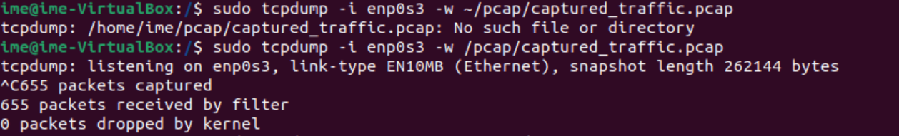
Writing at a pcap file:
sudo tcpdump -i enp0s3 -w /pcap/captured_traffic.pcap
This command will capture network traffic on the "enp0s3" network interface and save it to the "/pcap/captured_traffic.pcap" file within the "/pcap" directory.

Slide 11
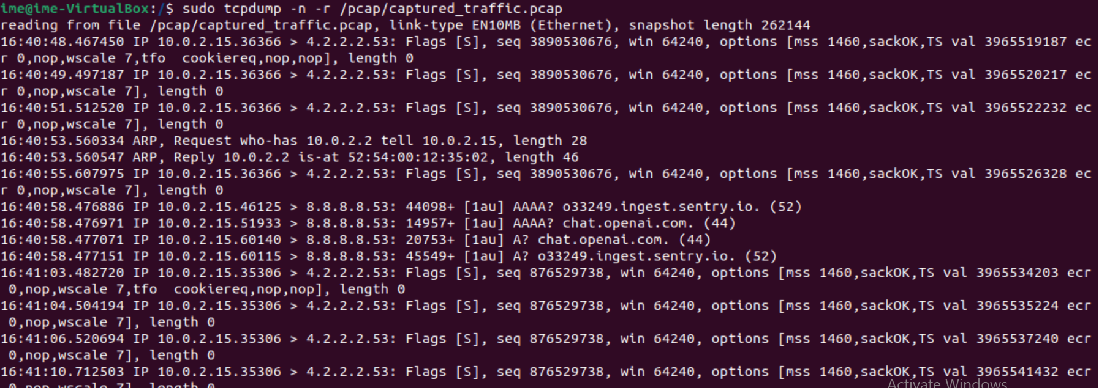
Reading from pcap file:
sudo tcpdump -n -r /pcap/captured_traffic.pcap
By running this command tcpdump will read the contents of the PCAP file and display the captured network traffic on your terminal, showing details like source and destination IP addresses, ports, packet sizes, timestamps, and more.

Slide 12
Command line utility with zeekcontrol

Slide 13

Run Zeekctl:
sudo ./zeekctl
Zeekctl (sometimes referred to as "Zeek Control") is a utility for managing and controlling Zeek, a powerful network security monitoring tool.
Zeekctl provides a set of commands and features that make it easier to configure, start, stop, and manage Zeek instances, especially in more complex deployment scenarios.
Zeek commands to Run:
>Zeek start : zeek is started
>Zeek deploy : zeek is started then it is stopped
>Zeek stop : zeek is stopped
>Zeek diag: to troubleshoot zeek installation

Slide 14
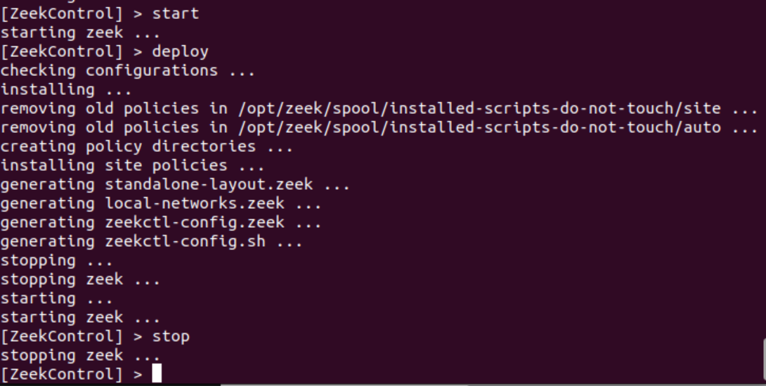
zeek start, deploy and stop

Slide 15
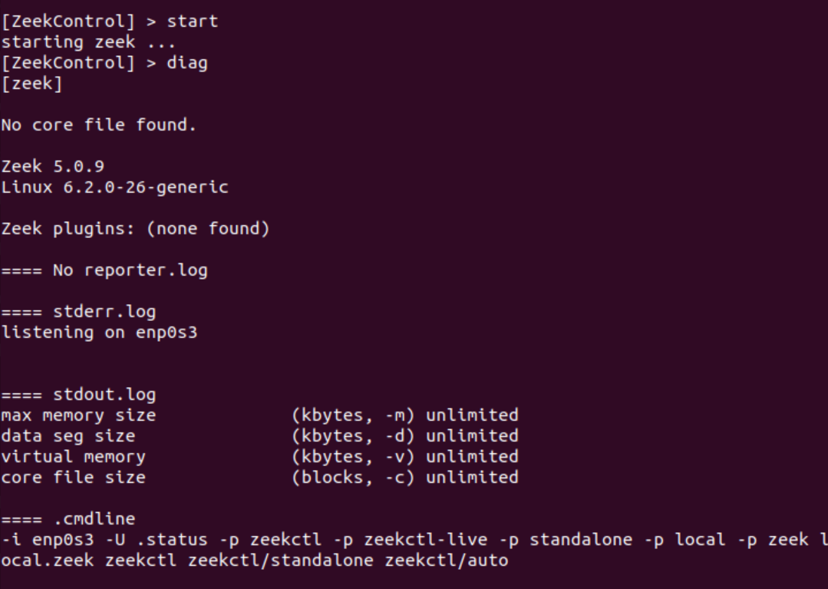
zeek diag
If there are errors while trying to start the Zeek instance, you can view the details with the diag command. If started successfully, the Zeek instance will begin analyzing traffic according to a default policy and output the results in $opt/zeek/logs/current directory.

Slide 16
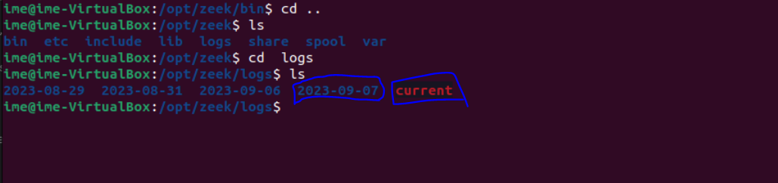
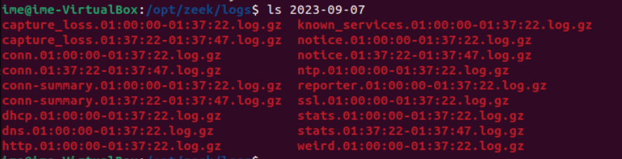
zeek diag : compressing and storing the log files
Here the current directory is empty before stopping the zeek instance using zeekctl. There are folders named with the date when the folder was created.
The log files in the $opt/zeek/logs/current directory are compressed and moved into the current day named folder "2023-09-07" inside the $opt/zeek/logs directory.

Slide 17
Notification and log file update

Slide 18
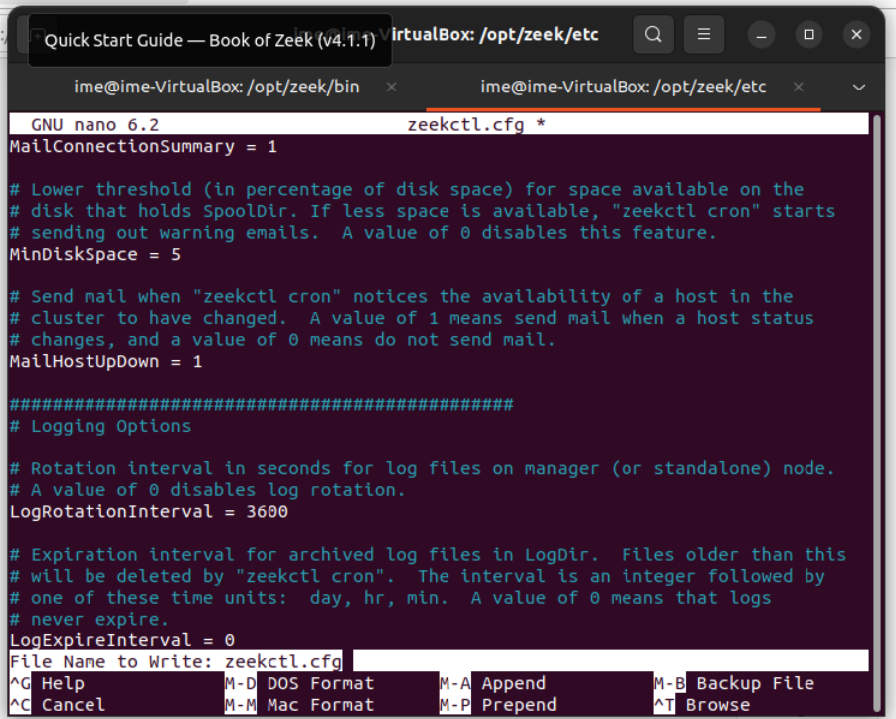
Open zeekctl.cfg > nano zeekctl.cfg
MailTo: Change the email address to desired email address
LogRotationInterval: Adjust the log archival frequency to the desired value. This value is typically specified in seconds.

Slide 19
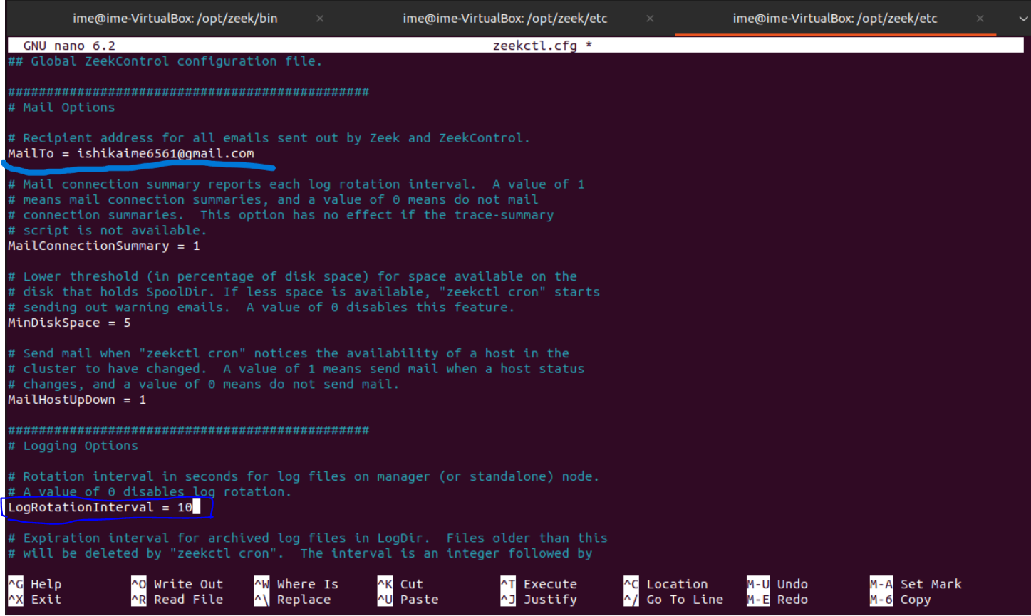
MailTo : ishikaime6561@gmail.com and LogRotationInterval= 10

Slide 20
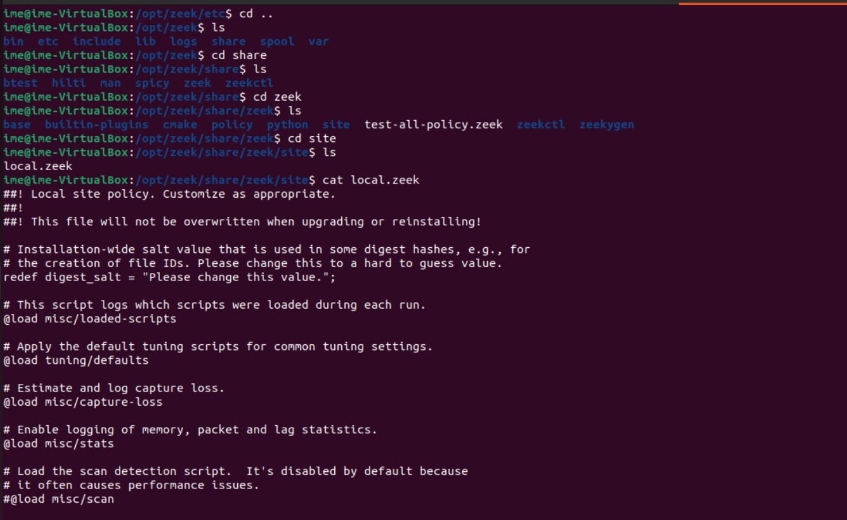
Go to define a rule:
cat /opt/zeek/share/zeek/site/local.zeek
Inside local.zeek, all the policies of zeek are defined. We can define a rule and trigger an event that will alert us through email system.

Slide 21
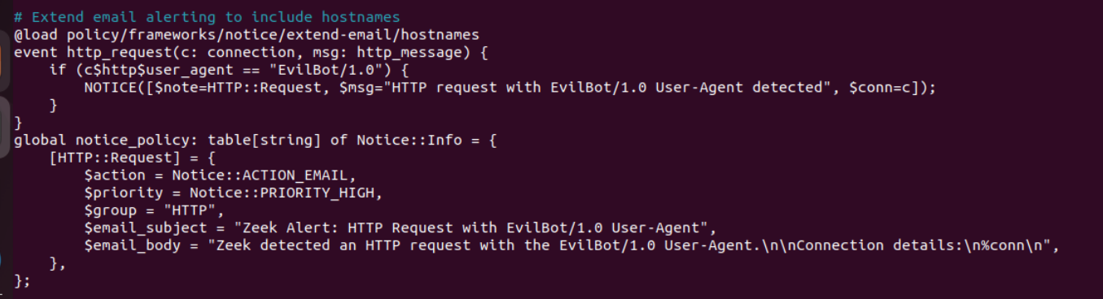
Define a rule:
To trigger an alert email with the modified Zeek policy and the changed email address, a network event needs to be created that matches the updated rule in the Zeek policy.
In this case, the modified policy is to generate an alert when an HTTP request contains the user agent string "EvilBot/1.0"

Slide 22
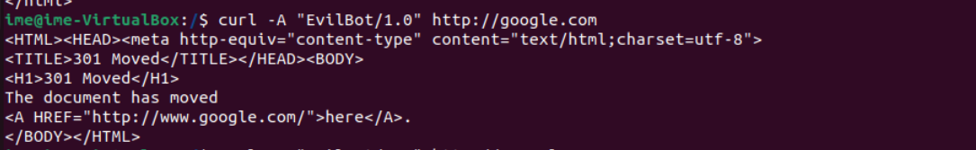
curl -A "Evilbot/1.0" http://google.com
To trigger an alert email with the modified Zeek policy and the changed email address, a network event needs to be created that matches the updated rule in the Zeek policy.
In this case, the modified policy is to generate an alert when an HTTP request contains the user agent string "EvilBot/1.0"
Zeek will send an email notification to the updated email address specified in the MailTo setting ( In our case, ishikaime6561@gmail.com) of Zeek configuration.

Slide 23
Browsing Log files

Slide 24
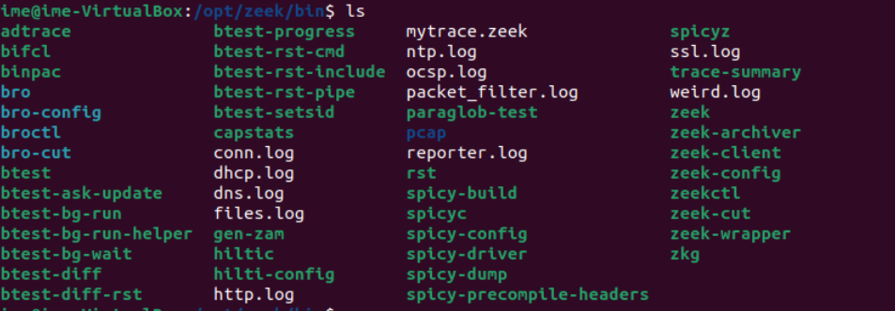
Finding log files in /opt/zeek/bin
Here all log files are located, conn.log, dhcp.log, ssl.log,notice.log, known_services.log, dns.log, weird.log etc.

Slide 25
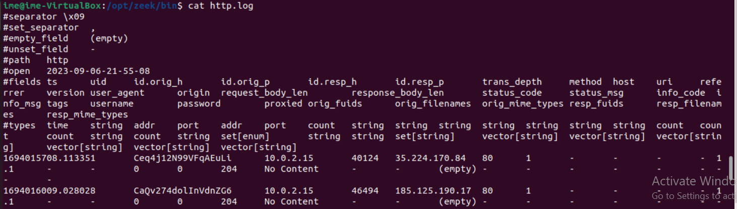
cat http.log
http.log is one of the log files generated by Zeek (formerly known as Bro) during network traffic analysis. This log file contains detailed information about HTTP (Hypertext Transfer Protocol) traffic observed on the network.​
Logs that deal with analysis of a network protocol will often start like this: a timestamp, a unique connection identifier (UID), and a connection 4-tuple (originator host/port and responder host/port). The UID can be used to identify and correlate all logged activity (possibly across multiple log files) associated with a given connection 4-tuple over its lifetime.

Slide 26
conn.log
Contains an entry for every connection seen on the wire, with basic properties such as time and duration, originator and responder IP addresses, services and ports, payload size, and much more. This log provides a comprehensive record of the network’s activity.
notice.log
Identifies specific activity that Zeek recognizes as potentially interesting, odd, or bad. In Zeek-speak, such activity is called a “notice”.
known_services.log
This log file contains the services detected on the local network and are known to be actively used by the clients on the network. It helps in enumerating what all services are observed on a local network and if they all are intentional and known to the network administrator.
weird.log
Contains unusual or exceptional activity that can indicate malformed connections, traffic that doesn’t conform to a particular protocol, malfunctioning or misconfigured hardware/services, or even an attacker attempting to avoid/confuse a sensor.

Slide 27

Thank you

